Slide 1
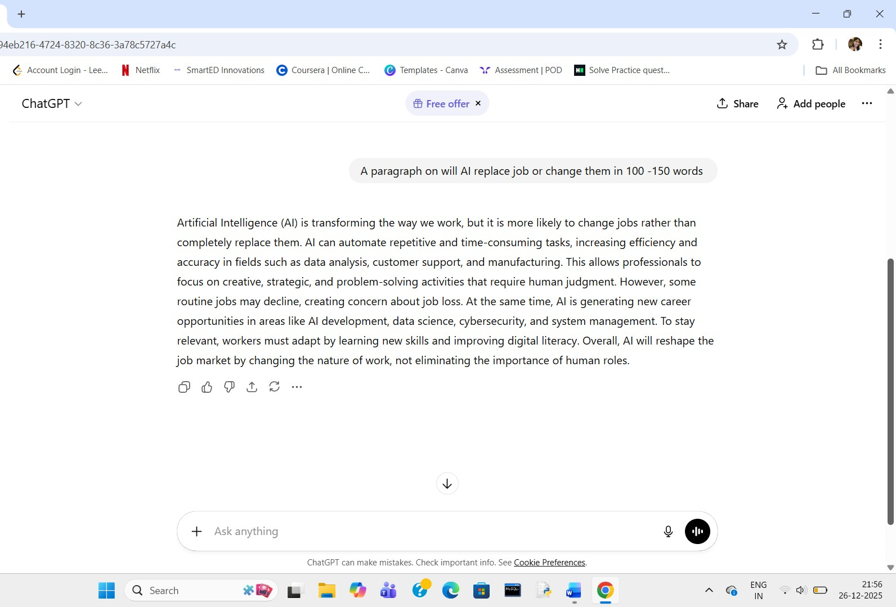
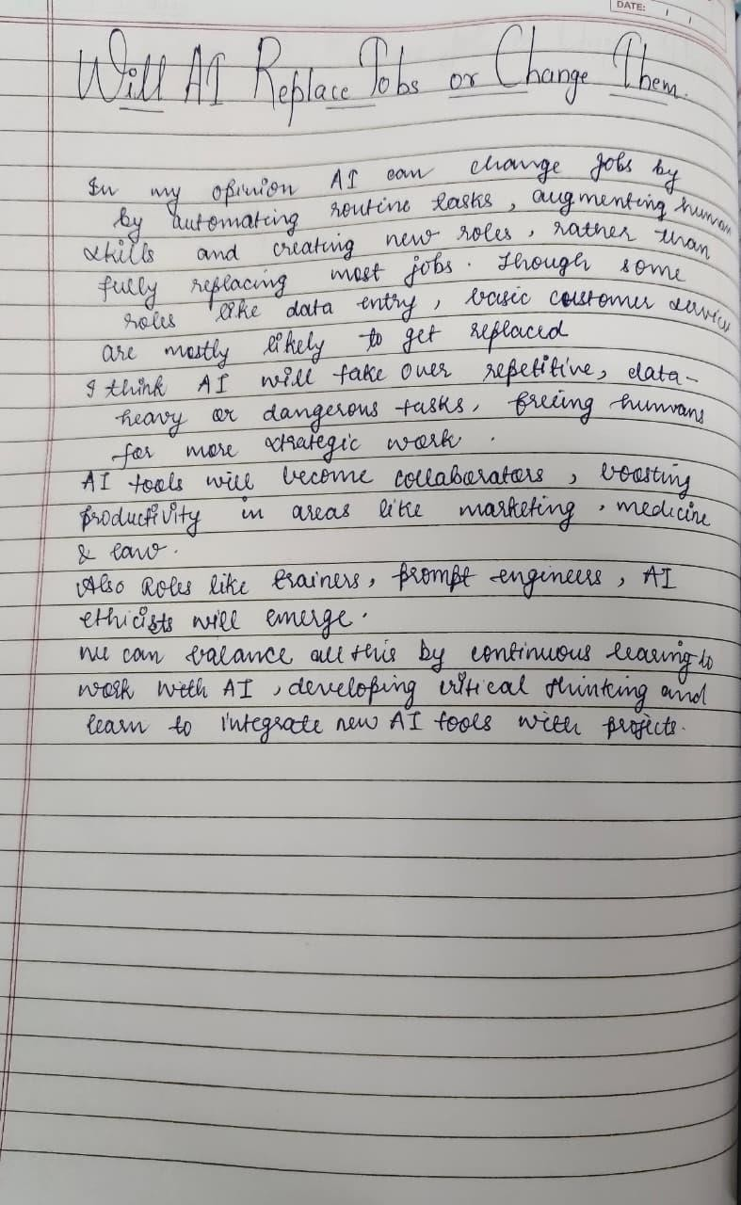

Slide 2
The AI-written paragraph is more organized, formal, and balanced, presenting points in a clear and logical flow with proper vocabulary. It focuses on factual
information and maintains a neutral tone throughout.
On the other hand, a human-written paragraph may include more personal opinions, emotions, or real-life
examples, making it feel more relatable and expressive.
Human writing can show creativity and individual perspective, while AI writing emphasizes clarity and
correctness. Overall, AI writing is useful for quick, wellstructured content, whereas human writing adds depth,
originality, and emotional understanding to the topic.

